Slide 1

THE TECH PULSE
Analyzing current and emerging trends in programming languages, databases and frame works
by balaprasad chimule
Completion date : 15/02/2025

Slide 2



OUTLINE
Executive Summary
Introduction
Methodology
Results
Visualization – Charts
Dashboard
Discussion
Findings & Implications
Conclusion
Appendix

Slide 3

EXECUTIVE SUMMARY
INTRODUCTION:
Overview of the survey on programming languages, databases and webframeworks
KEY FINDINGS:
Programming languages: Most programming languages used: HTML, JavaScript, SQL
Databases: Most popular databases: PostgreSQL, MicrosoftSQL, MySQL
Webframeworks: Spring Boot, React, ASP.NET CORE
RECOMMENDATIONS:
Developers should focus on versatile languages like HTML and Javascript
CONCLUSION:
Reinforce the need for continuous learning and adapting to new trends.
FUTURE OUTLOOK:
Emphasis on staying updated with evolving technologies to maintain competitiveness.

Slide 4

INTRODUCTION
OVERVIEW:
Overview of the survey on programming languages, databases and webframeworks
PURPOSE:
Purpose of the survey is to analyze current trends and preferences in tech industry
PARTICIPANTS:
Survey included responses from a diverse group of professionals across different age groups and education levels
SCOPE:
Topics covered: Covering diverse range of programming languages, databases, and web frameworks
Methodology: Data collection through online surveys and interviews with industry professionals

Slide 5

METHODOLOGY
QUESTIONNAIRE DEVELOPMENT:
Development of a comprehensive questionnaire to capture data on programming languages, databases, and web frameworks.
DATA COLLECTION:
Conducted through online surveys and interviews with industry professionals and developers. Reached to industry professionals across different age group and education levels
SAMPLING:
Targeted a diverse group of participants including developers, IT professionals, and industry experts
DATA ANALYSIS & WRANGLING:
Trend identification: Used excel for data collection, organization, and preliminary analysis.
Data visualization: Employed looker studio for advanced data visualization, trend analysis, and reporting.

Slide 6
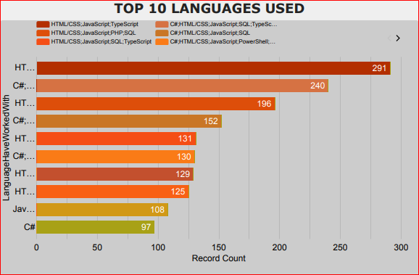
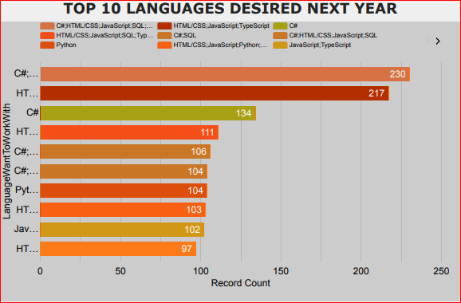
PROGRAMMING LANGUAGE TRENDS
Current Year
Next Year

Slide 7
PROGRAMMING LANGUAGE TRENDS - FINDINGS & IMPLICATIONS
Findings
HTML:
Html has seen significant increase over the past few years.
JAVASCRIPT FRAMEWORKS:
There has been a rapid growth in the use of javascript frameworks like spring boot, react, asp.net core.
EMERGING LANGUAGES:
New programming languages like c# and sql have been gaining tractions.
Implications
DEMAND FOR HTML PROFICIENCY
As html's popularity grows, there is an increasing demand for developers proficient in html.
JAVASCRIPT FRAMEWORK EXPERTISE:
With the rise of javascript frameworks, developers need to become proficient in these tools to stay competitive.
ADOPTION OF NEW LANGUAGES:
The emergence of new languages requires organizations to stay updated and adopt these technologies to maintain a competitive edge.

Slide 8
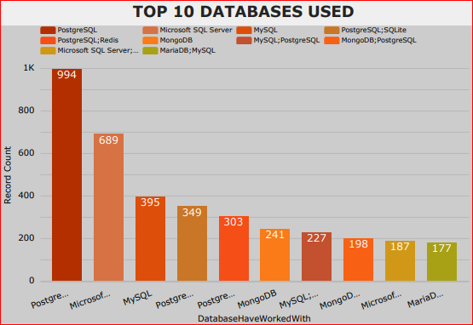
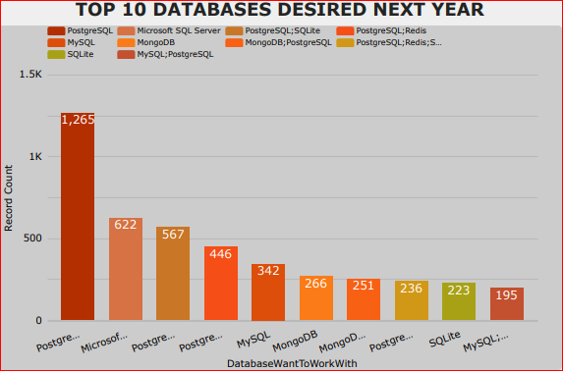
DATABASE TRENDS
Current Year
Next Year

Slide 9
DATABASE TRENDS - FINDINGS & IMPLICATIONS
Findings
PostgreSQL:
The most widely used database among the respondents
Microsoft SQL Server:
Significant usage and interest among participants
MongoDB and MySQL:
Increasing popularity and adoption
Implications
PostgreSQL demand:
Organizations should focus on PostgreSQL training and development to leverage it’s widespread
Proficiency in Microsoft SQL Server:
Companies should ensure their teams are proficient in Microsoft SQL Server to meet industry demand.
Adoption of MongoDB and MySQL:
Business should consider adopting MongoDB and MySQL to stay competitive and meet growing demand.

Slide 10

DASHBOARD
LOOKER STUDIO DASHBOARD LINK:
https://lookerstudio.google.com/s/lU5tqyXwmA0

Slide 11
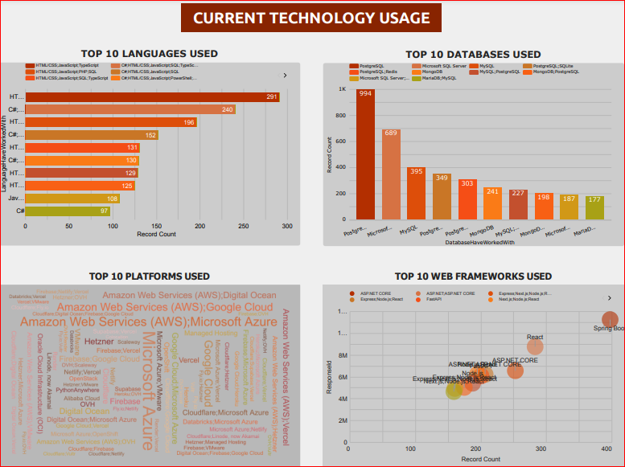
DASHBOARD TAB 1

Slide 12
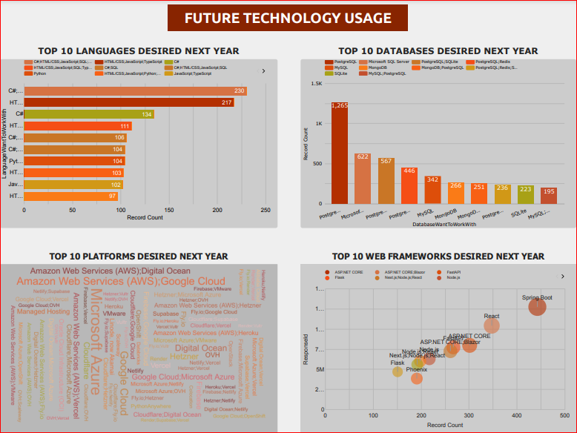
DASHBOARD TAB 2

Slide 13
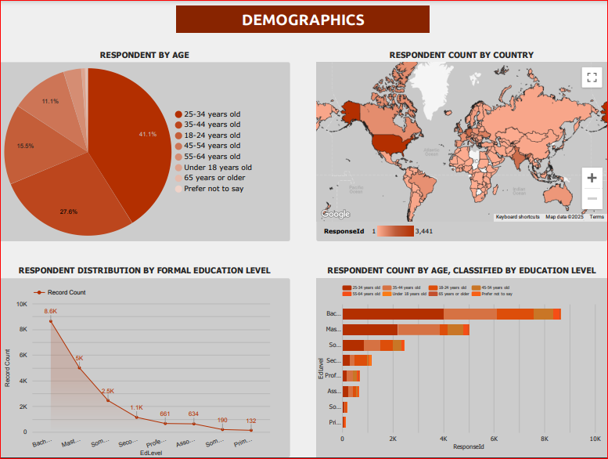
DASHBOARD TAB 3

Slide 14
DISCUSSION
CURRENT TECHNOLOGY USAGE:
Languages: HTML, C#, and JavaScript are the most used.
Databases: PostgreSQL leads, followed by Microsoft SQL Server and MySQL.
Web Frameworks: React, ASP.NET Core, and Spring Boot are the most popular.
Platforms: Node.js, FastAPI, and Express are widely used.
FUTURE TECHNOLOGY TRENDS:
Languages: Developers want to adopt more C#, HTML, and Python.
Databases: PostgreSQL remains dominant, with rising interest in MongoDB and SQLite.
Web Frameworks: React and ASP.NET Core stay strong, with growing demand for FastAPI and Flask.
Platforms: Next.js and Node.js show increasing adoption.
DEMOGRAPHICS:
Age: Majority are 25-34 years old (41.3%), followed by 35-44 years old (27.3%).
Education: Most respondents hold a Bachelor’s degree (8.6K), followed by Master’s (5K).

Slide 15
OVERALL FINDINGS & IMPLICATIONS
Findings
CURRENT TECH TRENDS:
HTML, C# and JavaScript are the most used languages with PostgreSQL as the top database
FUTURE TECH ADOPTION:
Growing interest in Python, PostgreSQL and FasAPI indicating a shift towards modern technologies.
DEMOGRAPHICS:
Majority of respondents are aged 25-34 years old and hold a bachelor’s degree
Implications
WORKFORCE SKILL DEMAND:
Companies should focus on upskilling in python, FastAPI and PostgreSQL to align with future trends
TECH STACK EVOLUTION:
The rise of frameworks like Next.js and FastAPI suggests a shift towards modern web technologies.
HIRING & EDUCATION:
Organizations should target young professionals with bachelor’s degrees while offering training for emerging technologies

Slide 16
JOB POSTINGS

Slide 17
POPULAR LANGUAGES

Slide 18

CONCLUSION
TECHNOLOGY TRENDS ARE EVOLVING:
Developers are shifting towards modern frameworks like Next.js, FastAPI and Flask.
DEMAND FOR PYTHON & POSTGRESQL:
These technologies are growing in popularity, indicating a shift in backend development.
DEMOGRAPHICS INFLUENCE WORKFORCE TRENDS:
The majority of developers are young professionals with a bachelor’s degree, shaping hiring and training strategies.
FUTURE READINESS IS KEY:
Organizations should invest in emerging technologies and skill development to stay competitive.

Slide 19

APPENDIX
Include any relevant additional charts, or tables that you may have created during the analysis phase.

